Slide 1


Analysis OF HIV/AIDS care AT HOWARD BROWN HEALTH
Riham, Terry, Annanya, Jason

Slide 2


Background
According to USAIDS*, there are 36.9 million people worldwide living with HIV/AIDS as of 2017
75% of people living with HIV globally were aware of their HIV status in 2017. However, 25% of world population still need access to HIV testing services. HIV testing is an essential gateway to HIV prevention, treatment, care and support services.
Howard Brown Health
A Federally Qualified Health Center who sees patients regardless of their ability to pay.
Served over 25,000 patients in 2018
4,794 patients living with HIV/AIDS
Source: https://www.hiv.gov/hiv-basics/overview/data-and-trends/global-statistics

Slide 3
Research Question: What Type of Patients Come to Howard Brown for HIV/AIDS Services?
To understand types of patients at Howard Brown for HIV/AIDS services, we analyzed a federal dataset from 2018 to understand demographic behavior and their ability to receive HIV treatment. We analyzed the following characteristics:
Race
Gender
Age
Poverty level
Insurance
Housing status
Viral suppressions

Slide 4
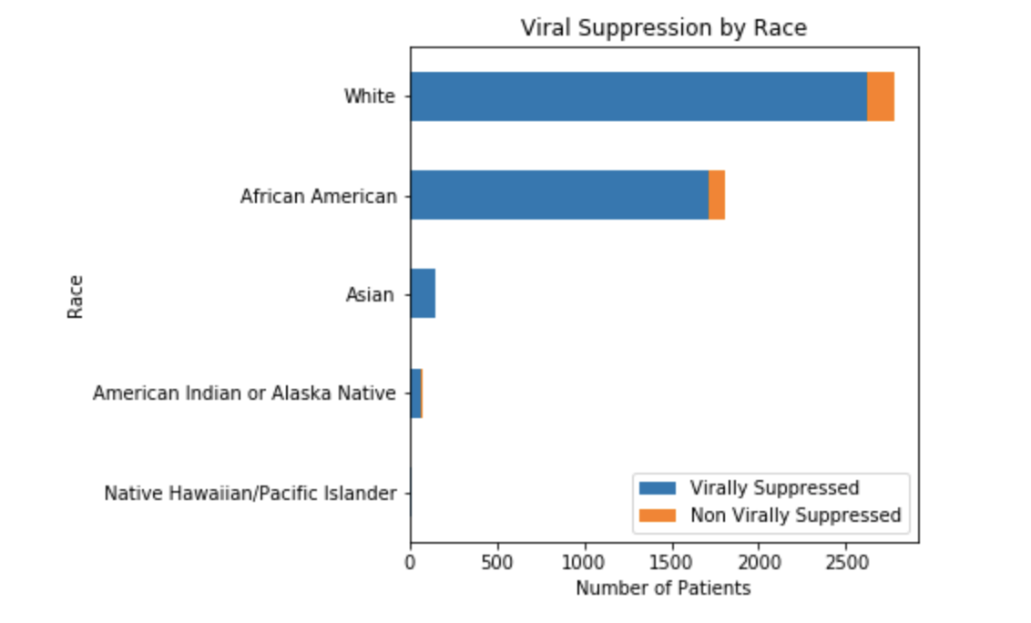
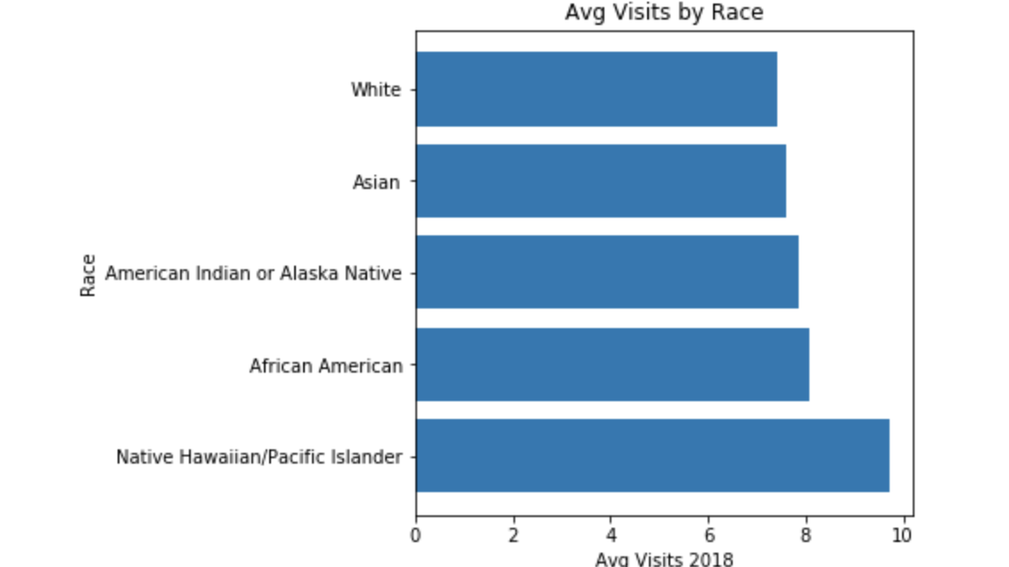
RACE

Slide 5
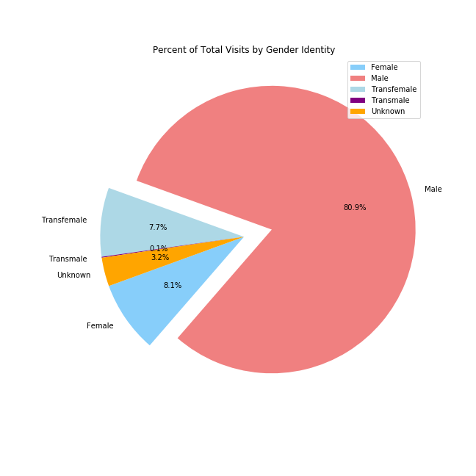
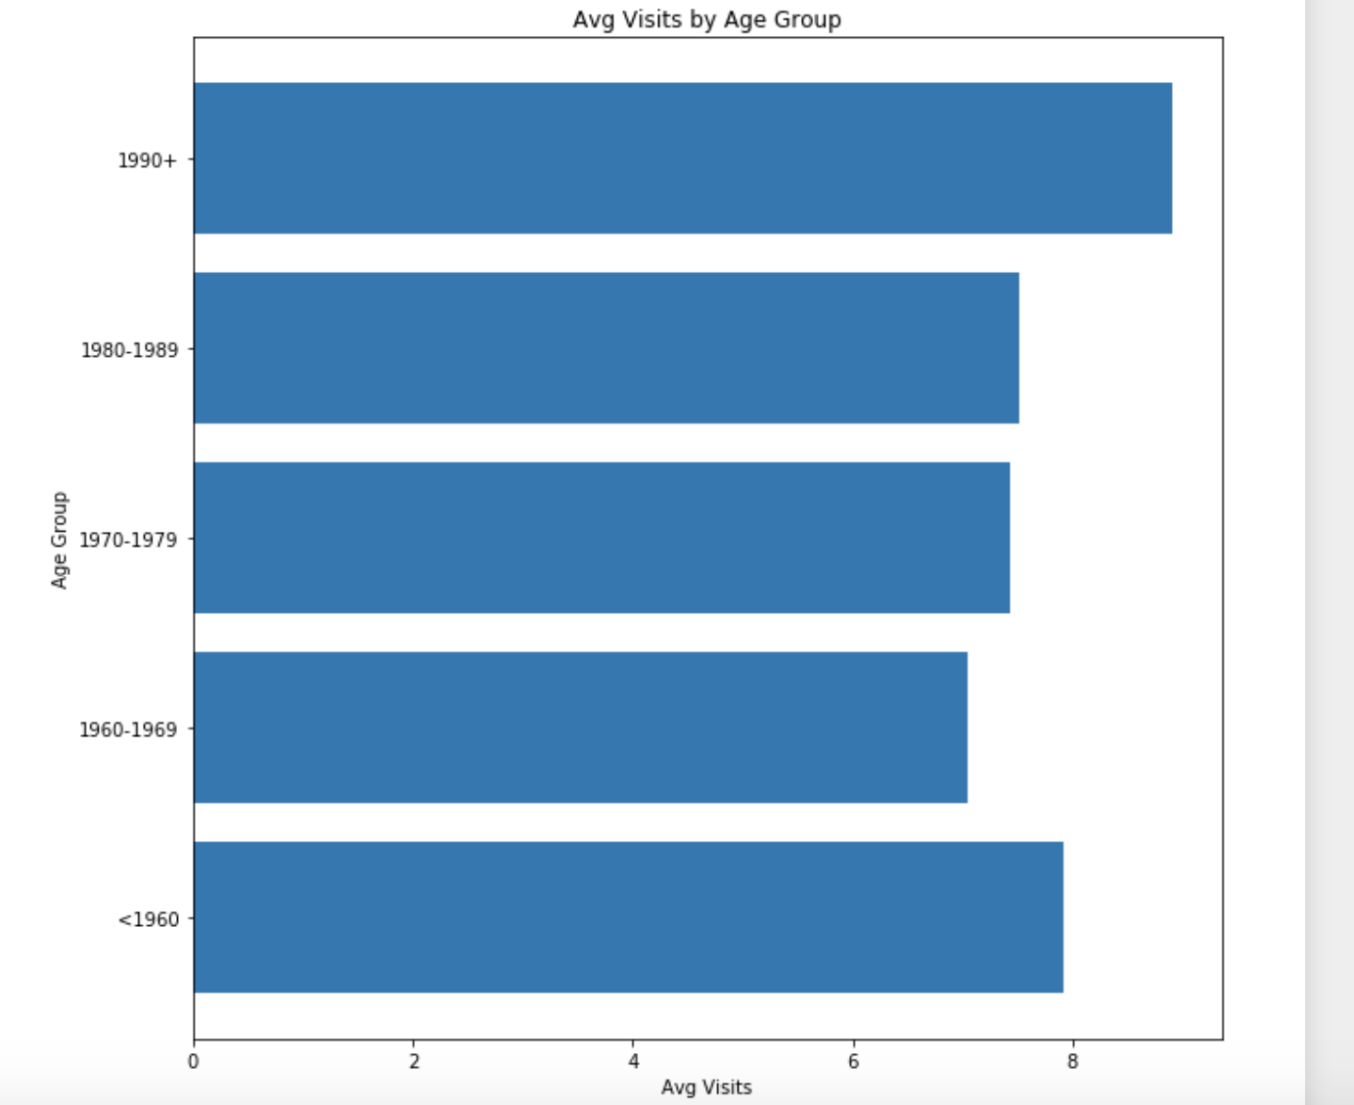
Gender & AGE

Slide 6
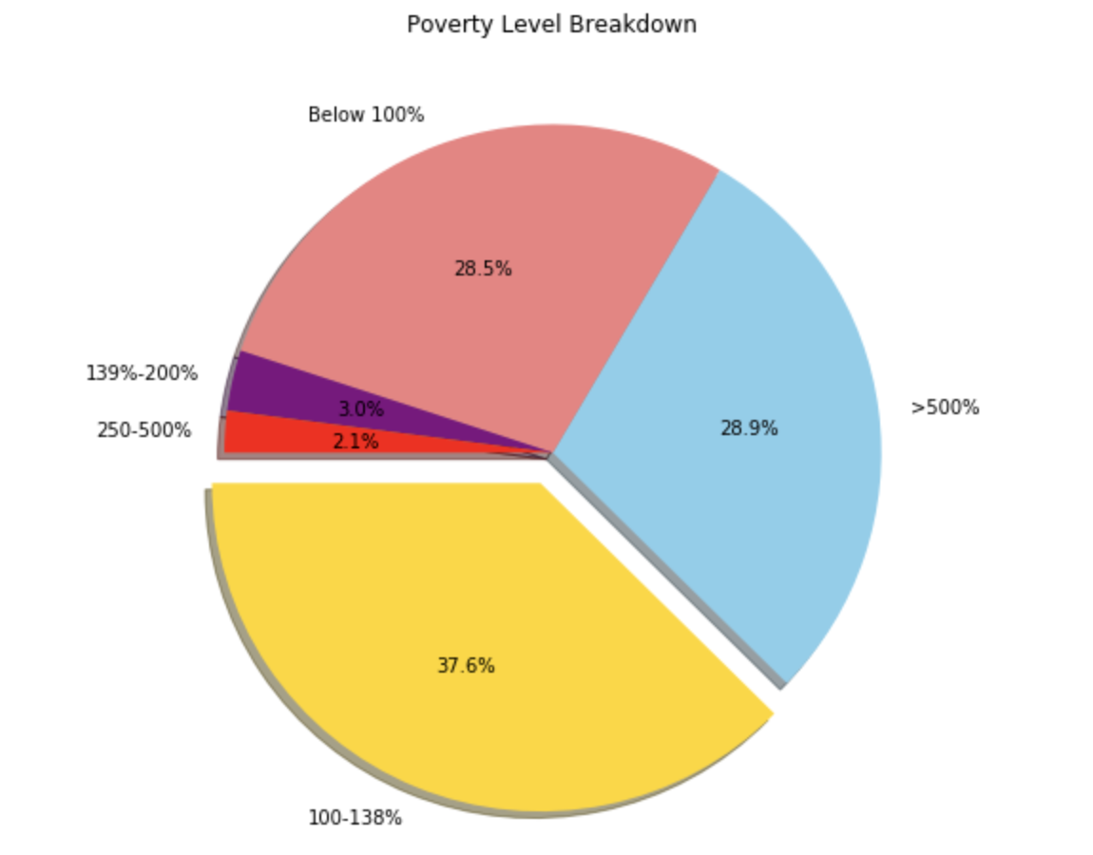
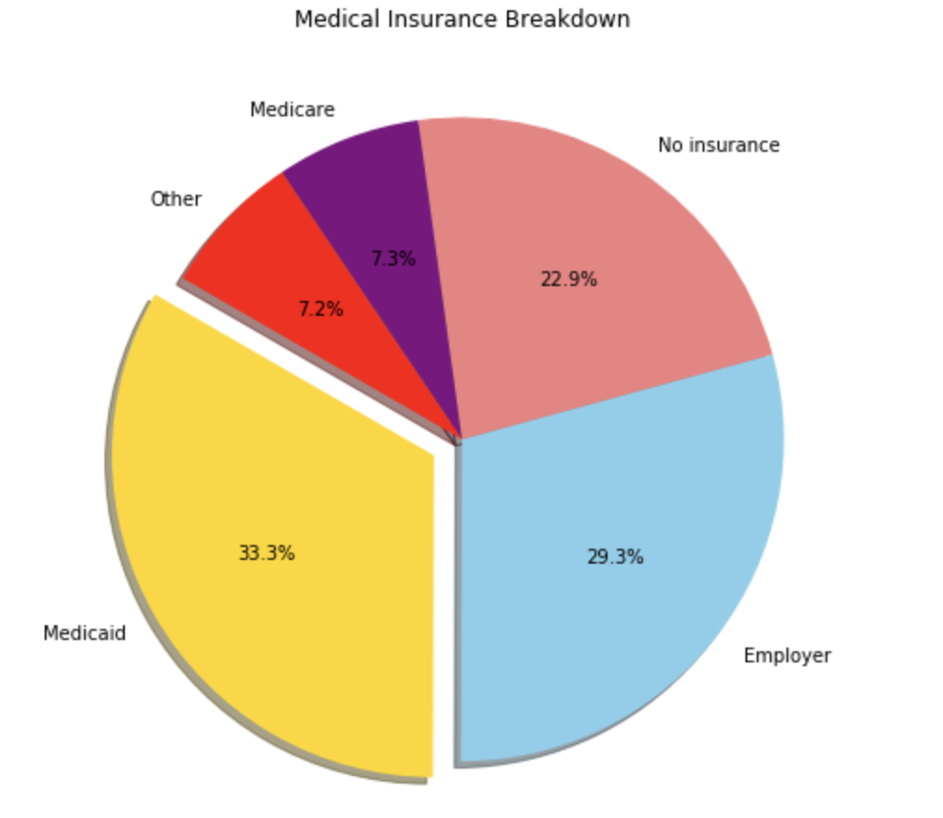
POVERTY LEVEL AND INSURANCE

Slide 7
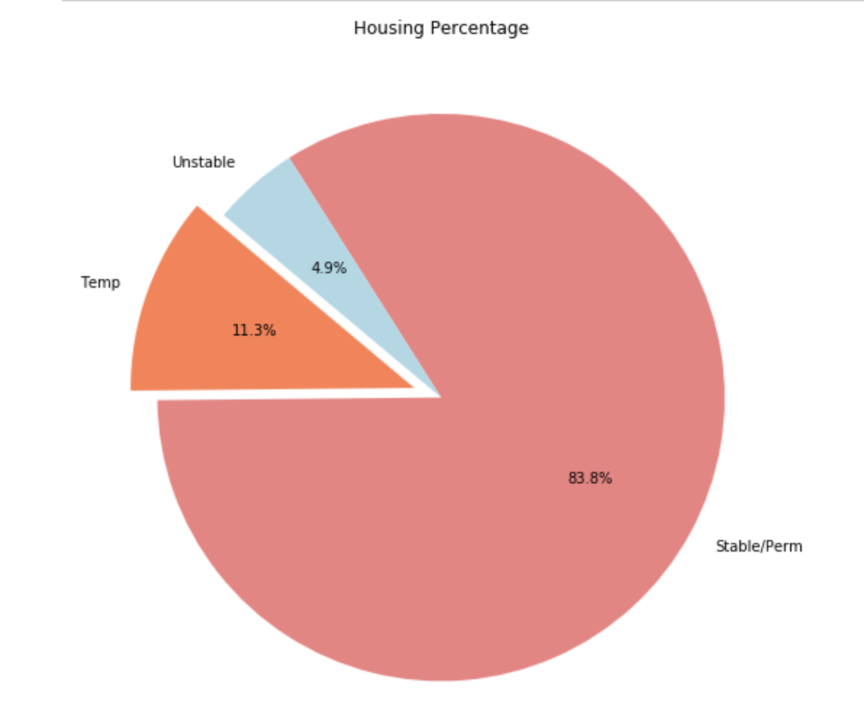
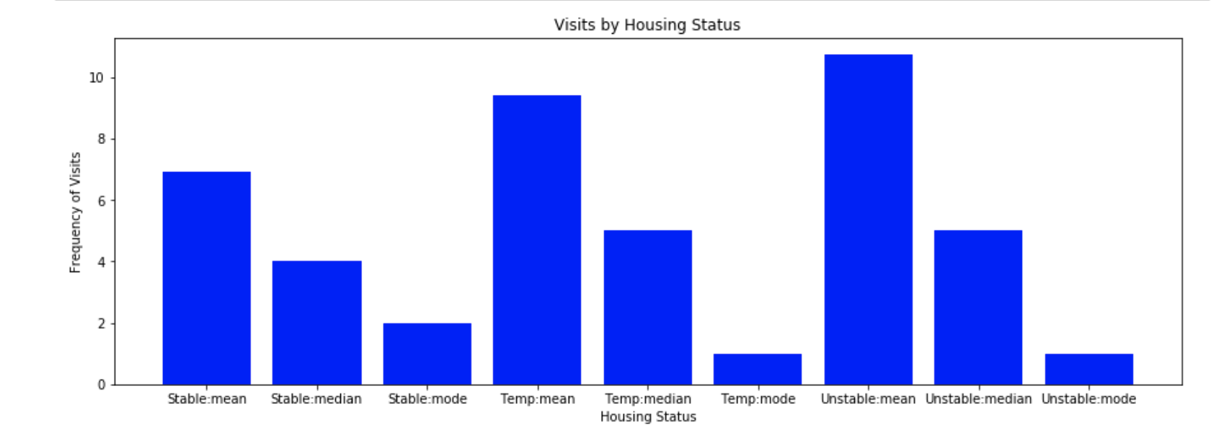
HOUSING STATUS

Slide 8
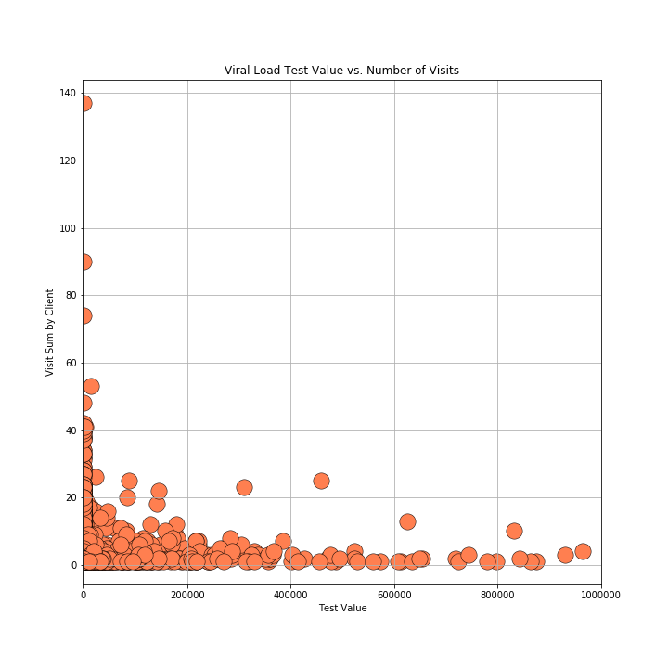
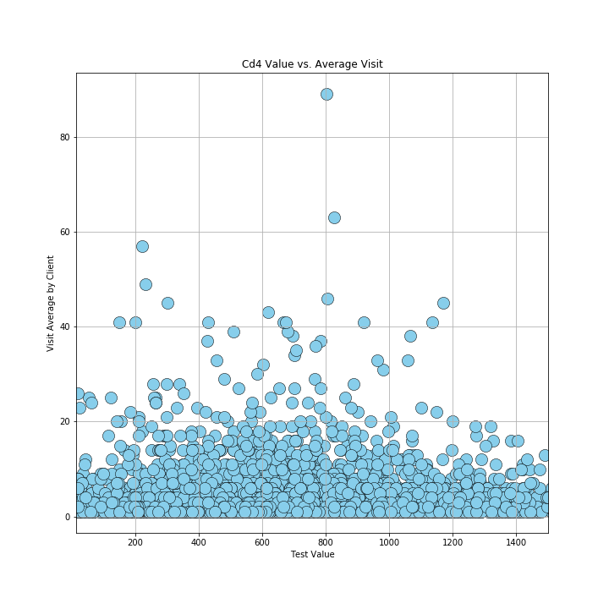
VIRAL SUPRESSION and cd4 Count
< 200 is considered to be virally suppressed
Cd4 count – Snapshot of how well your immune system is doing and counts the white blood cells

Slide 9
Outliers
Excluded the following outliers from our analysis:
Date of diagnosis
Unknown Race or Ethnicity
Other types of insurance

Slide 10
FINDINGS
Based on the analysis, we came to the following analysis:
There is a correlation between viral suppression and frequency of visits. Patients with more visits were virally suppressed.
This same relationship did not exist with Cd4 count.
Patients unstably housed had higher average of number of visits.

